Slide 1

University of Minnesota Deep Learning (EE 4940) Guest Lecture Applications of Deep Neural Networks Intelligent Textbooks and MicroSims Case Study: Large Healthcare Organization
https://github.com/dmccreary/deep-learning-course/blob/main/slides/U-of-MN-Guest-Lecture.pptx
Dan McCreary
April 20th, 2025

Slide 2
Today’s Agenda
The Accelerating Pace of Change of AI
Applications of Deep Learning
Limitations of LLMs
LLMs are models of language, not models of the world
AGI will need to be able to build precise models of the world
Intelligent Textbooks
MicroSims
Case Study: Large Healthcare Company
Use of Machine Learning, LLMs and Concerns about Liability
Q&A – 10 minutes

Slide 3
Knowledge Representation
“The key to artificial intelligence has always been the representation.”
Jeff Hawkins
Author of 1,000 Brains Theory

Slide 4
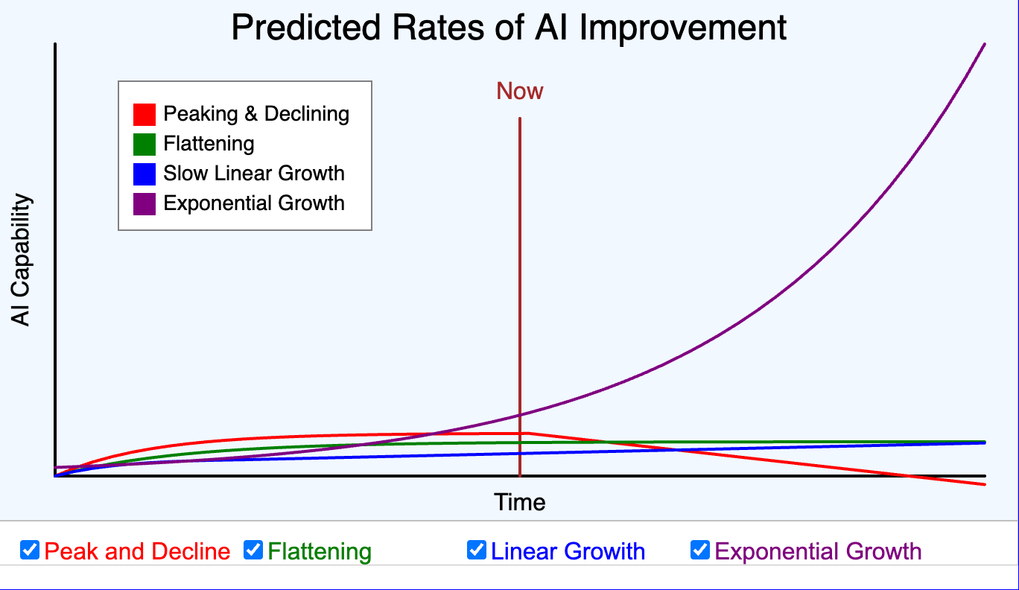
https://dmccreary.github.io/deep-learning-course/sims/four-futures/

Slide 5
Question for Class
How many are using generative AI to help you learn?
How many think the pace of AI development
Has already peaked, is unsustainable and will decline
Will be flat
Is growing at a liner rate
Is growing at an exponential rate?

Slide 6
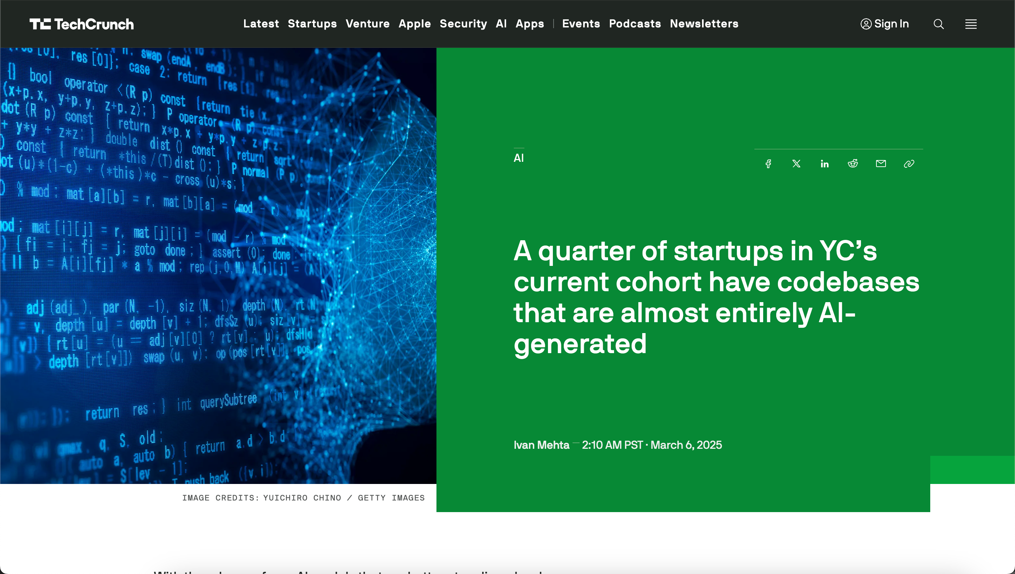
Recent Headline in TechCrunch March 6th 2025
https://techcrunch.com/2025/03/06/a-quarter-of-startups-in-ycs-current-cohort-have-codebases-that-are-almost-entirely-ai-generated/?guccounter=1

Slide 7
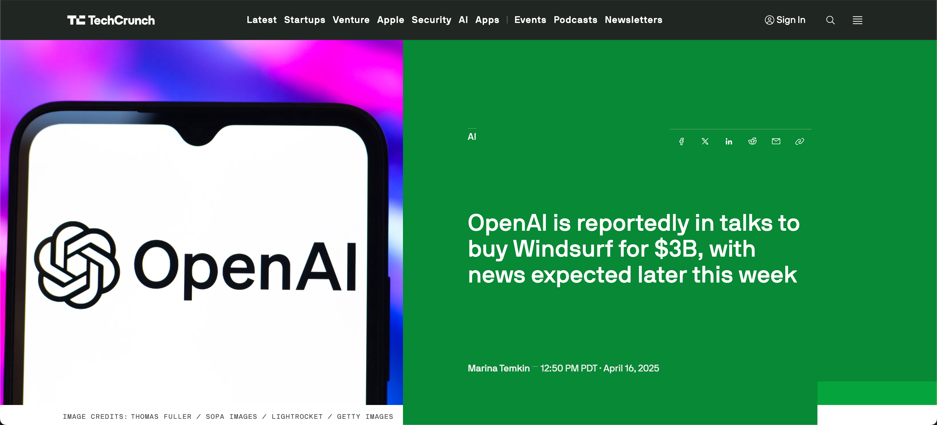
OpenAI Purchase Windsurf?, April 16th, 2025

Slide 8
2025 Y-Combinator Statistic
In the 2025 Bay Area Y-Combinator “Shark tank” for venture-capital funding, in ¼ of the companies, over 95% of their code was written by generative AI
25%
Over 95% Written by AI
Total Startups
Percent of Code Written by AI

Slide 9
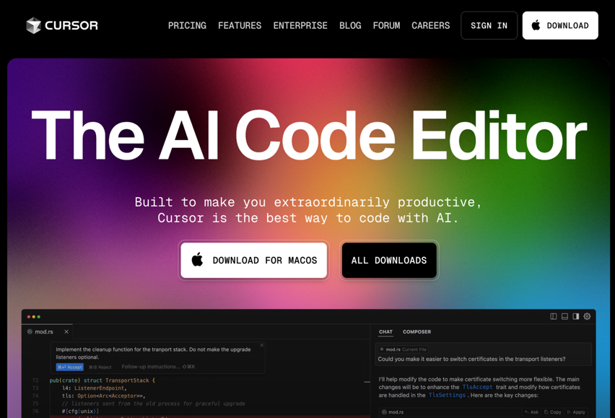
Leading Agentic AI IDE: Cursor
Not Google
Not Amazon
Not Microsoft
Not OpenAI
Mostly powered by Anthropic Claude

Slide 10
Review of Systems Thinking Causal Loop Diagrams
B
R
Balancing Loops
Example: Thermostat
Reinforcing Loops
Example: Nuclear Reaction
https://dmccreary.github.io/graph-systems-thinking/

Slide 11
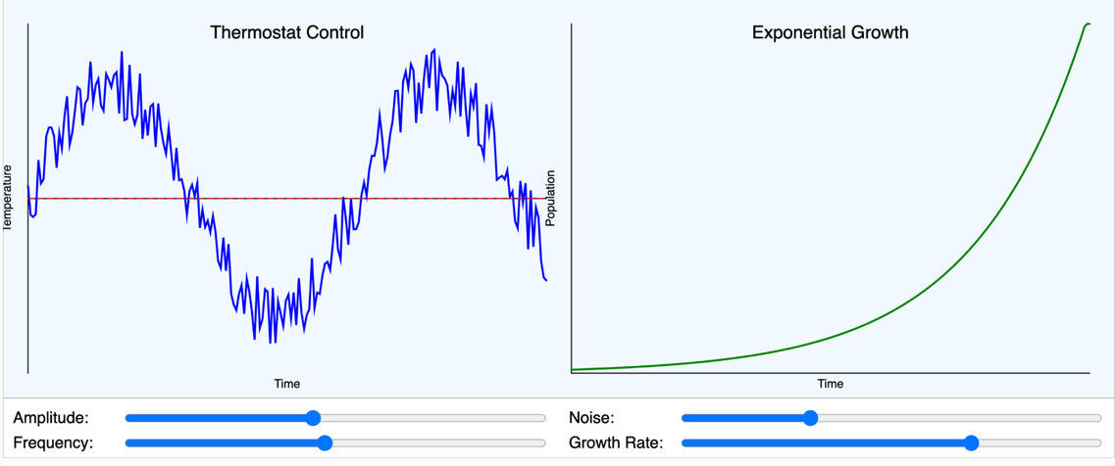
Balanced vs. Reinforcing
B
R

Slide 12
AI Agent Positive Feedback Loop
AI Agent
R
Used to Create

Slide 13
Agent MCP Positive Feedback Loop
MCP
Model
Context
Protocols
Used to Create
AI Agent
R
Increase Capabilities
R
Used to Create

Slide 14
Other Reinforcing Factors Accelerating AI
Hardware
Better Hardware
GPU, AI FPGA, graph accelerators
More Data
Better labeled data
Using AI to accelerate data labeling
Better Algorithms
Academic Leadership
Fear of Missing Out (FOMO)
Data
R
R
AI
Algorithms
R
R
R
FOMO
Leadership

Slide 15
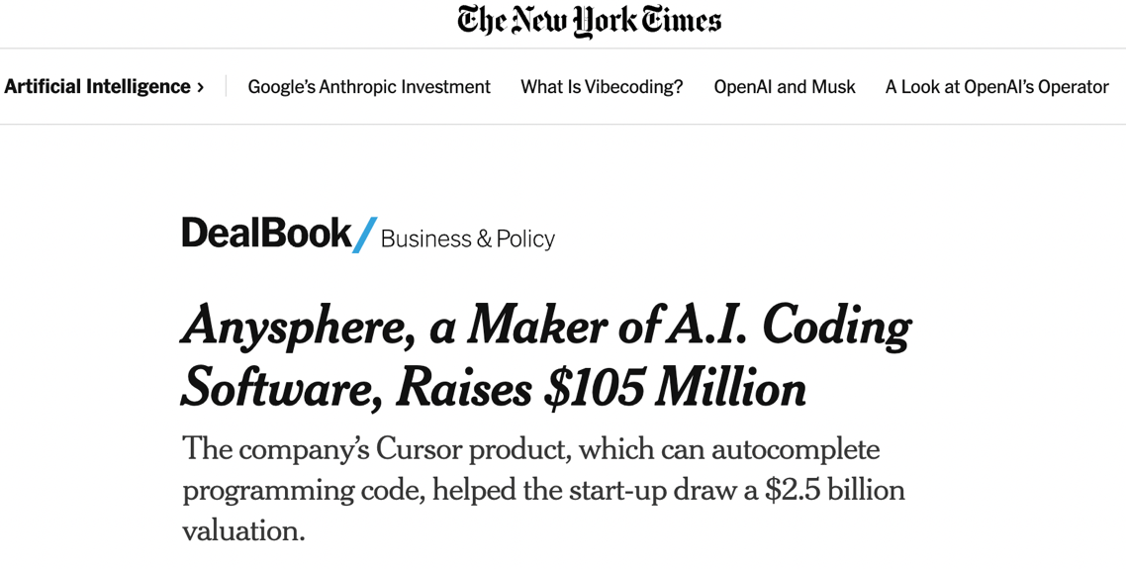
1/14/2005
https://www.nytimes.com/2025/01/14/business/dealbook/anysphere-cursor-25-billion-valuation.html

Slide 16
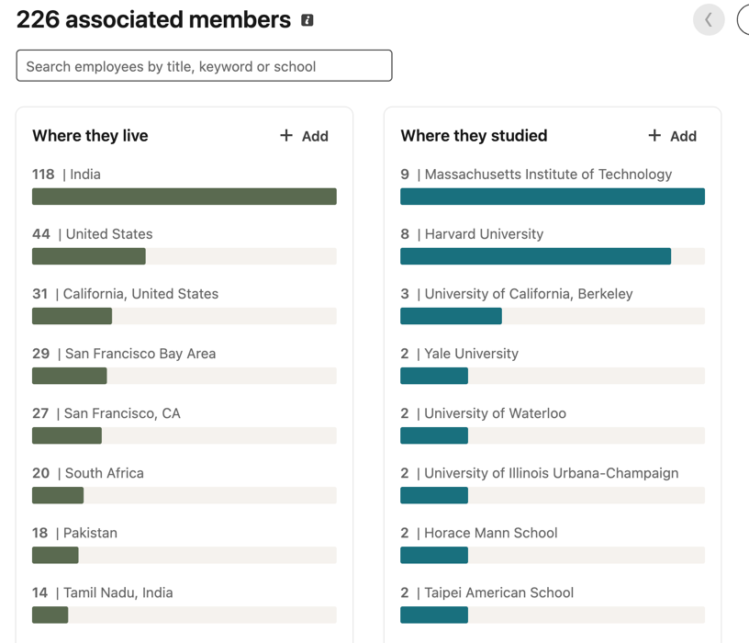
Anysphere has 226 employees

Slide 17
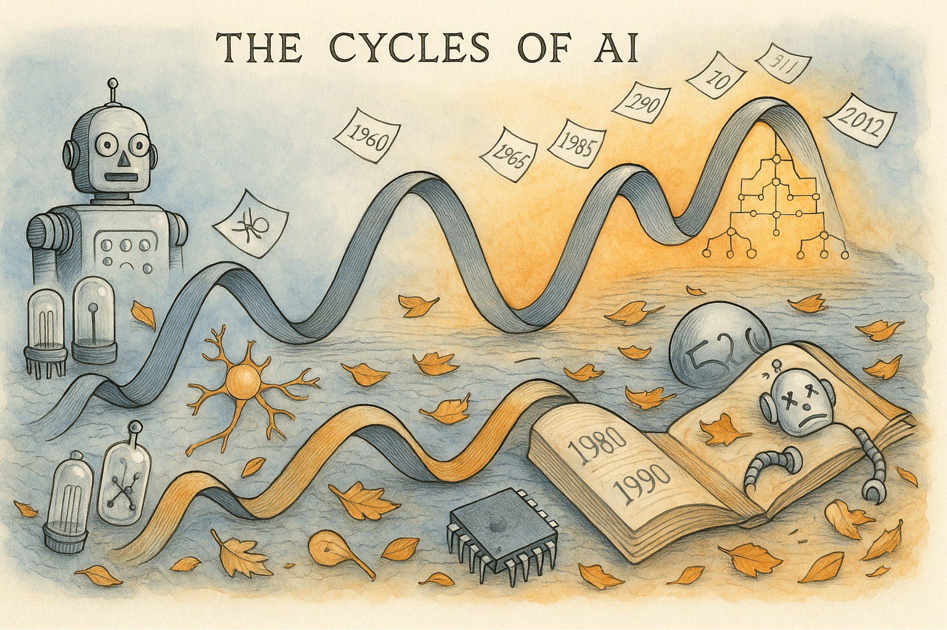
https://dmccreary.github.io/deep-learning-course/stories/ai-winters/

Slide 18
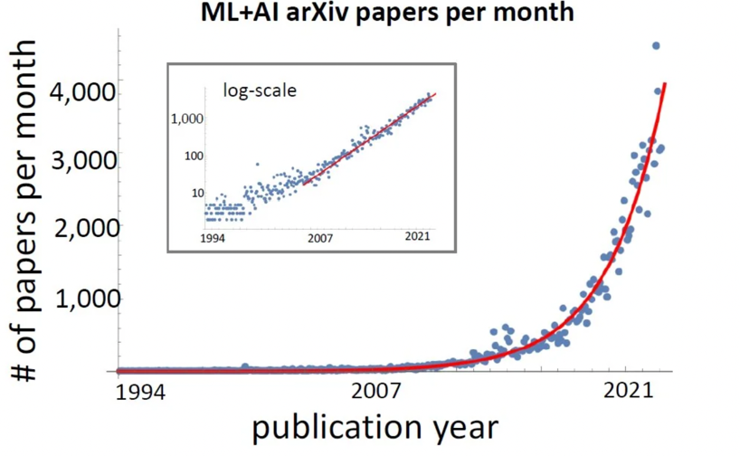
Rate of Change is Getting Faster
Doubling every 24 months
https://www.reddit.com/r/singularity/comments/xwdzr5/the_number_of_ai_papers_on_arxiv_per_month_grows/

Slide 19
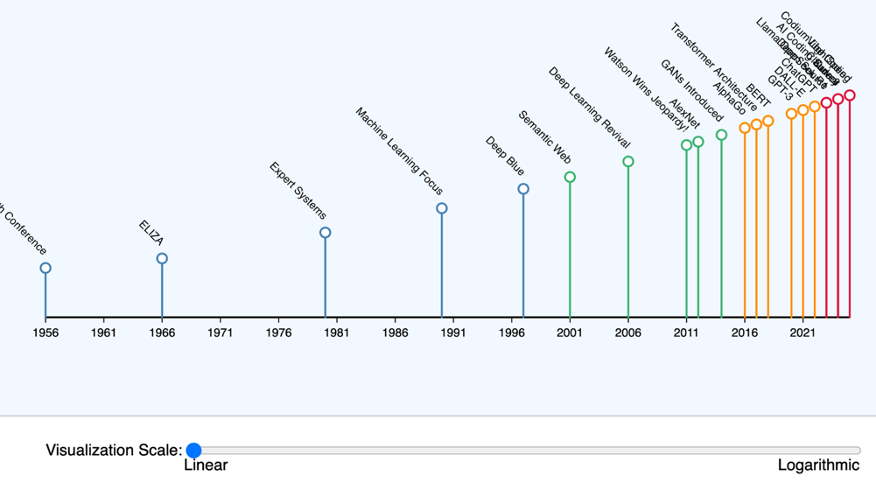
Accelerating Pace of AI Innovation
https://dmccreary.github.io/intelligent-textbooks/sims/ai-pace-accelerating/

Slide 20

A Young Lady's Illustrated Primer A fully adaptive intelligent learning device Storytelling customized to each child’s needs From Neal Stephenson’s 1995 Cyberpunk Novel “Diamond Age”

Slide 21
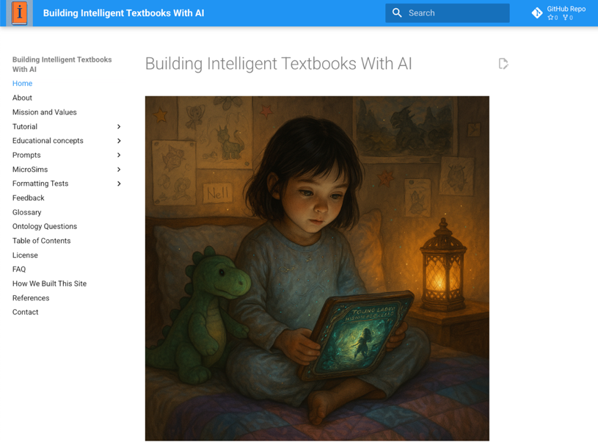
https://dmccreary.github.io/intelligent-textbooks/

Slide 22
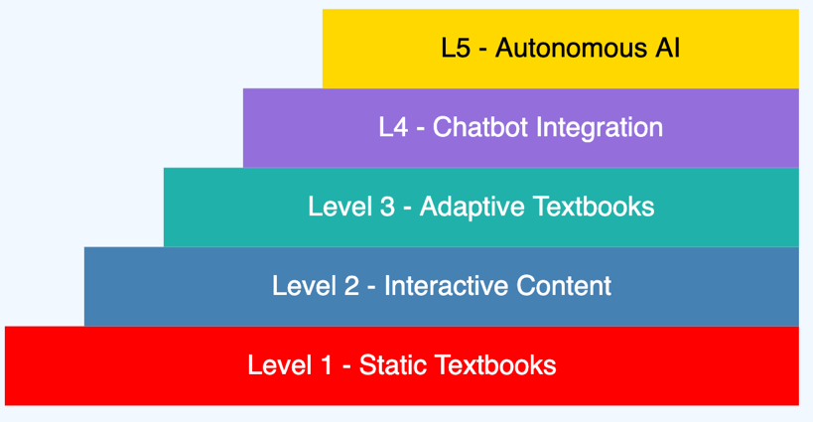
Five Levels of Intelligent Textbooks
https://dmccreary.github.io/intelligent-textbooks/sims/book-levels/

Slide 23
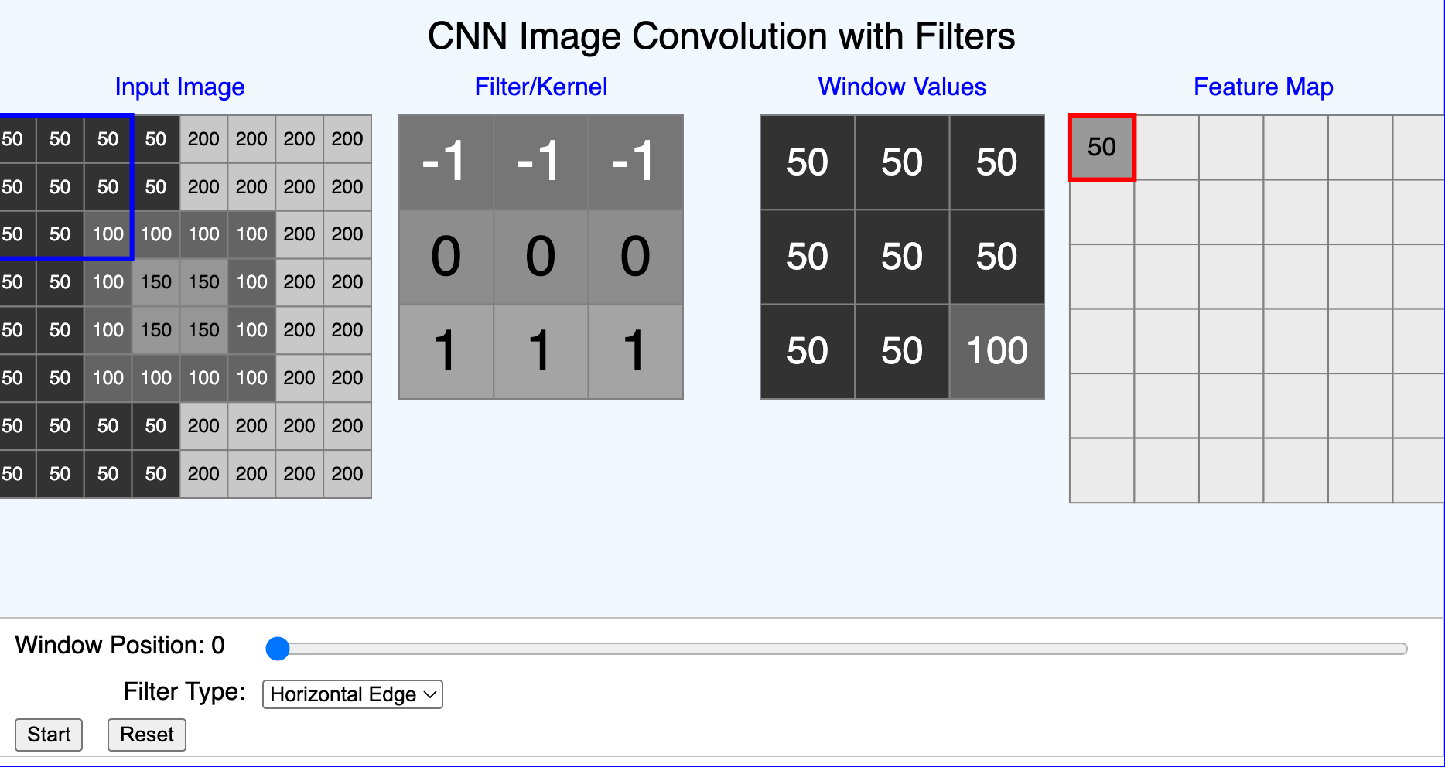
Convolution With Filters
https://dmccreary.github.io/microsims/sims/least-squares/

Slide 24
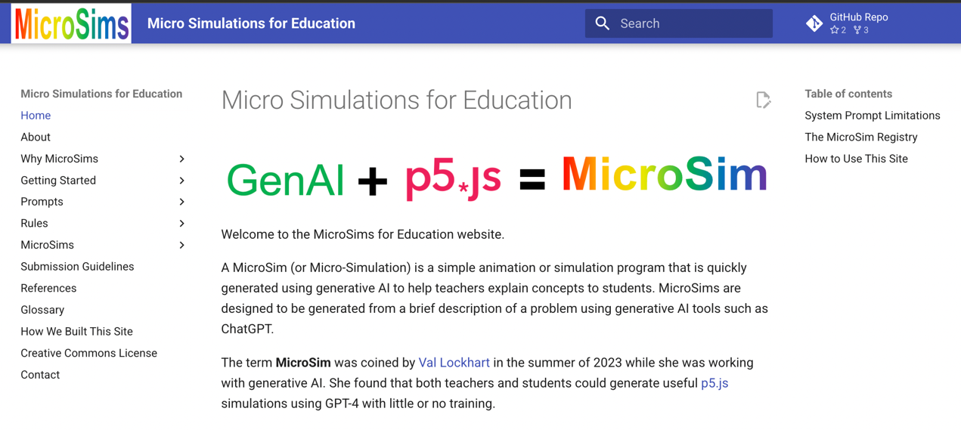
https://dmccreary.github.io/microsims/

Slide 25
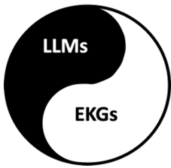
The Complementary Nature of LLMs and EKGs
Large Language Models
Statistical
Models of language
Designed to predict the next token
Likely to hallucinate
Contains Knowledge of the Outside World
Enterprise Knowledge Graphs
Deterministic
Models of your customer
Designed for holistic knowledge traversal
Precise graph queries
Contains Knowledge of your Internal Organization

Slide 26
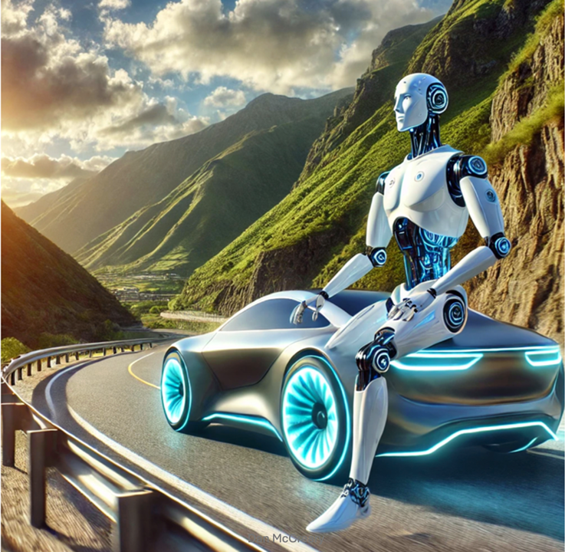
Agent Guardrails

Slide 27
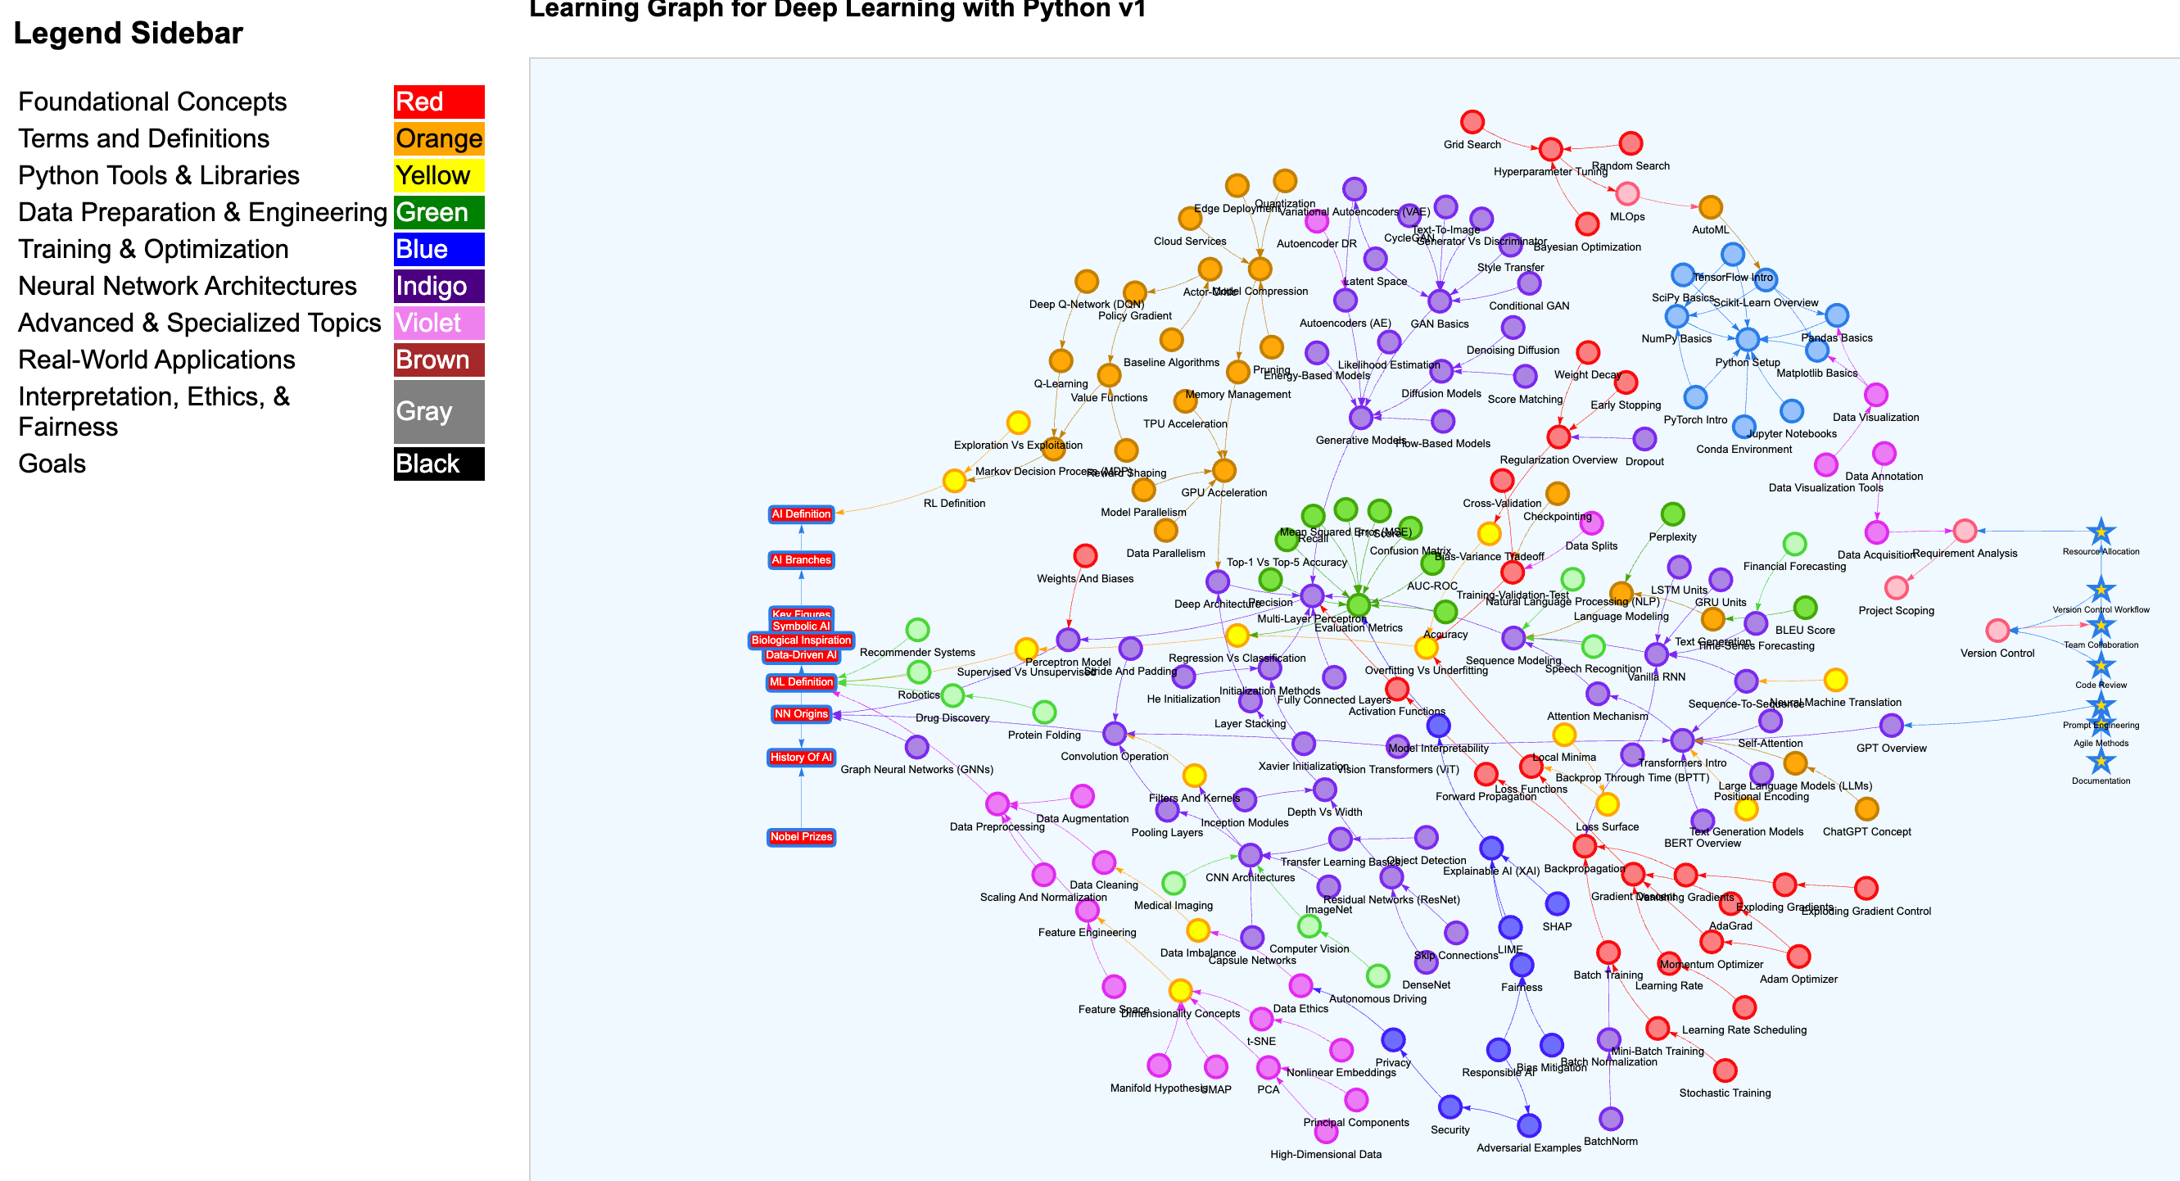
Learning Graph for Deep Learning with Python
https://dmccreary.github.io/deep-learning-course/sims/learning-graph/view-graph.html

Slide 28
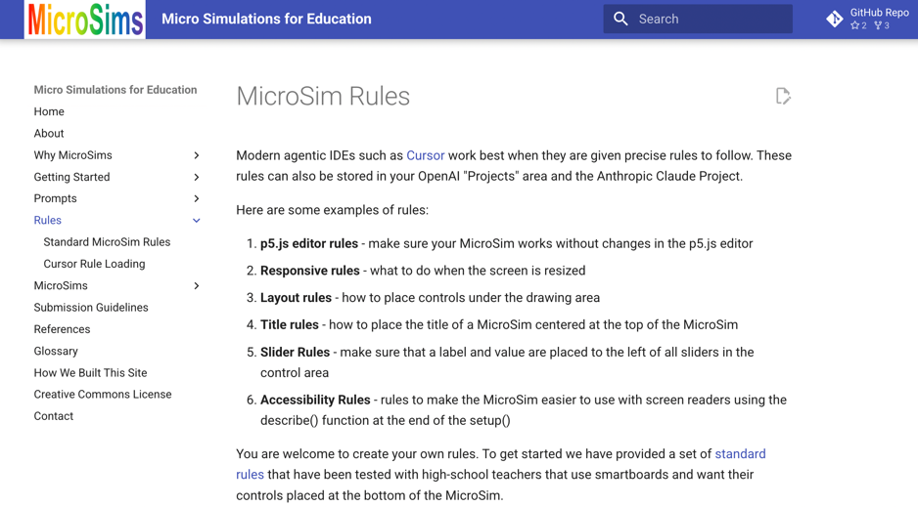
IDE Agent Generation Rules
https://dmccreary.github.io/microsims/rules/

Slide 29
Sample Intelligent Textbooks
Agents Course: https://dmccreary.github.io/agents-course/
Deep Learning Course: https://dmccreary.github.io/deep-learning-course/
Intelligent Textbooks: https://dmccreary.github.io/intelligent-textbooks/
MicroSims: https://dmccreary.github.io/microsims/
Learning Graphs: https://dmccreary.github.io/learning-graphs/
MicroPython: https://dmccreary.github.io/learning-micropython/
Clocks and Watches: https://dmccreary.github.io/clocks-and-watches/
Graph Algorithms: https://dmccreary.github.io/graph-algorithms/
Signal Processing: https://dmccreary.github.io/signal-processing/
Circuits: https://dmccreary.github.io/circuits/
Systems Thinking: https://dmccreary.github.io/graph-systems-thinking/
Personal Finance with AI: https://dmccreary.github.io/personal-finance/
Maroon text developed with the help of the University of Minnesota

Slide 30
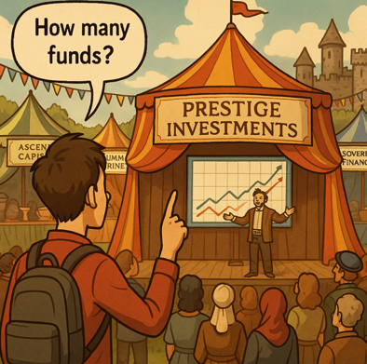

ChatGPT o1 Image Generation WOW!
Consistent character embeddings through a story
https://dmccreary.github.io/personal-finance/stories/selection-bias/

Slide 31
Healthcare GenAI Center of Excellence
2023 Case Study
Small team: 4 people
Ideation to Production Workflow
250 project ides submitted each year
150 good ideas that were not duplicates
50 approved by senior leadership
25 received funding
10 went to production
Focus on 18-month ROI analysis
Idea Funnel
250
10

Slide 32
Samples of Projects that Used Deep Learning
Software Coding Assistants - (clear ROI)
Medical Chart Billing Code Analysis (clear ROI)
Technical helpdesk chatbots - (clear ROI)
Call center chatbots – internal call center knowledge base lookup
Healthcare question chatbots – high risk
Benefit coverage chatbots – high risk
Clinical chart analysis for prior authorization approval
Positive approvals require NO explanation
Negative responses require complex human reviewed explanations
Answering Requests for Purchase (RFP)

Slide 33
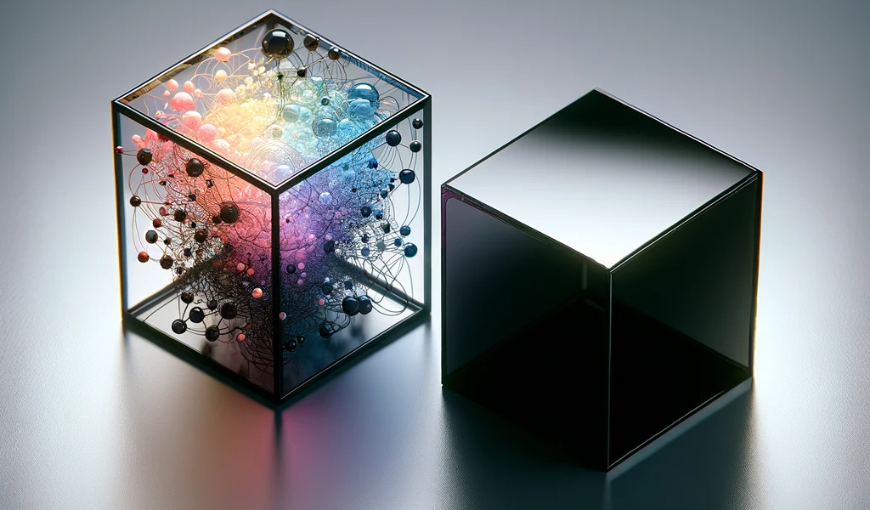
Explainable AI
Black box vs. White box models
DNNs don’t offer clear explanations of ”why” a decision was made
Building a explainable user interfaces increases cost by 3x

Slide 34

Clinical Discovery vs. Batch Reporting
Discovery
Overnight Batch
Interactive – results in seconds
Fixed Format
When dealing with large amount of clinical information (millions of patients), some queries run so slow on older computer systems (relational) that they take 10+ hours to run.
We call these queries “Overnight Batch Runs” and they are ideal for fixed-format reports.
“Discover” requires immediate fast results so we can continuously get feedback and modify the query to get more precise results.

Slide 35
What Databases is Best for Clinical Data Discovery?
Relational
Analytical (OLAP)
Key-Value
key
value
key
value
key
value
key
value
Column-Family
Graph
Document
http://www.manning.com/books/making-sense-of-nosql

Slide 36
Four Types of Training Data for LLMs
Image
Sequence (Language)
Graph (Relationships are Key)
Tabular (Convenient)

Slide 37
Graphs work well on high-variability data
Low Variability
High Variability
General Ledger (GL)
Claims
Drug Interactions
Clinical Data
Invoice
Benefit Plans
360 Applications
Star Rating
Shopping Cart
Providers
Genomics
Data Hubs
Most business systems fit somewhere on a spectrum of data variability
Highly regular systems, like a GL have low variability
Variability tends to grow over time as exceptions are introduced to a system
Few real-world systems can accurately predict future variability

Slide 38
How Is Clinical Data Unique?
Answer: Complexity, Variability and
RELATIONSHIPS
Activity
(FitBit)
Allergies
ADTs
Visits
Conditions
Calls
Claims
E-Mails
Touchpoints
Demographics
Searches
Vaccinations
Patient
Chats
Diseases
Social Determinants of Health
Medications
Genomics
Lab
Tests
Prescriptions
Adherence
Medical
Images

Slide 39
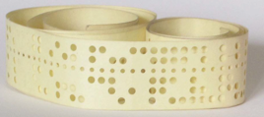
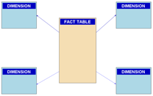

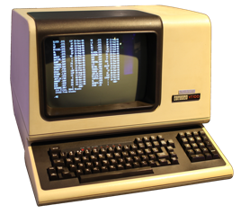
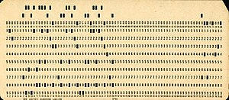
AI Helps us Move from Counting Rows to.. Intelligent Comparing
Counting
Comparing
Tabular Data +
Graph Data +
Unstructured Data (Text) +
Agents
Counting Rows in
Tabular Data

Slide 40
Direction vs. Distance
Never Mistake a Clear View for a Short Distance
- Paul Saffo
AI will democratize education worldwide
An MIT-quality education for every child in the world
Intelligent textbooks will be easier to build every month
Colleges will be rated on their average textbook level
(most of them are at zero today)
There are many challenges with MicroSim/Book integration into legacy LMSs built on old relational databases that don’t understand similarity

Slide 41

Call to Action
Use Generative AI to automate the boring stuff
Download the Cursor IDE or the Codium Windsurf IDE and build a MicroSim using our MicroSim rules
Watch some tutorial videos on agentic IDEs
”Just Do It!”

Slide 42
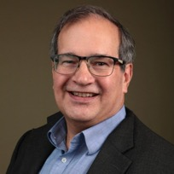
Questions
Please connect with me on LinkedIn:
https://www.linkedin.com/in/danmccreary/

